Slide 1
CS 211
Computer Architecture
Lab 05

Slide 2
Floating Point Arithmetic
IEEE 754 Floating Point Standard
Eg : Decimal
1.234 x 10³
Mantissa = 1.234
Exponent = 3
Eg : Binary
1.110011x2⁵

Slide 3
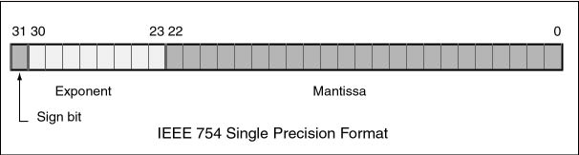
Floating point data in MIPS Registers
Sign bit:
1 for negative numbers
0 for positive numbers

Slide 4
Mantissa
Bits 0 to 22
23 bits binary representation of a 24 bits number that starts with 1
2^{0th} is presumed to contain a 1

Slide 5
Exponent
Bits 23 to 30
Its expressed using a biased integer
The true exponent is after subtracting 127 from the biased exponent (127 is referred to as the bias)
A biased exponent of +127 represents the actual exponent 0.
A biased exponent of +128 represents the actual exponent 1.
A biased exponent of +126 represents the actual exponent -1.
A floating point value of 0.0 is represented with a mantissa of 23 zero bits and an exponent of 8 zero bits.

Slide 6
Float Formula
value = (-1)^{s} × 1.M × 2^{E-127}
s is the sign bit (0 or 1)
M is the mantissa (000...000 to 111...111)
E is the biased exponent.

Slide 7
Example: 1.0
Sign bit = 0
Exponent = 01111111
Mantissa = 00000000000000000000000
Binary Representation:
0 01111111 00000000000000000000000
Final value: 0x3F800000

Slide 8
Example: -0.1
Sign bit = 1
Binary fraction for 0.1 is 0.0001100110011001100....
Mantissa = 10011001100110011001100
It should be left shifted by 4
Hence actual Exponent is -4
Exponent = 127-4 = 123
01111011

Slide 9
MIPS Floating Point Registers-
Coprocessor 1
32 single precision floating point registers
Each of 32 bits
Named : $f0 to $f31
8 bit exponent and 23 bit mantissa
Exponent bias = +127
16 Double precision floating point registers
Each of 64 bits
Named : $f0, $f2, $f4... (only even numbered, odd comes along in the pair)
11 bit exponent and 64 bits mantissa
Exponent Bias = +1023

Slide 10
Floating Point Arithmetic Instructions
• add.s $f0, $f1, $f2 #$f0 := $f1 + $f2
• sub.s $f0, $f1, $f2 #$f0 := $f1 - $f2
• mul.s $f0, $f1, $f2 #$f0 := $f1 * $f2
• div.s $f0, $f1, $f2 #$f0 := $f1 / $f2
• abs.s $f0, $f1 #$f0 := |$f1|
• neg.s $f0, $f1 #$f0 := - $f1

Slide 11
Floating Point Register Transfers
mov.s and mov.d copy data between floating-point registers.
mov.s fd, fs
Use mtc1 and mfc1 to transfer data between the integer registers $0-$31 and the floating-point registers $f0-$f31.
These are “raw” data transfers that do not convert between integer and floating-point representations.
mtc1 $t0, $f0 # $f0 = $t0
mfc1 $t0, $f0 # $t0 = $f0

Slide 12
Floating Point Register Transfers
There are also special loads and stores for transferring data between the floating-point registers and memory.
Base address is in integer registers
lwc1 $f2, 0($a0) # $f2 = M[$a0]
swc1 $f4, 4($sp) # M[$sp+4] = $f4

Slide 13
Floating Point Comparisons
c.le.s $f2, $f4 if $fs == $ft
condition bit = 1
else
condition bit = 0
c.eq.s $f2, $f4 if $fs < $ft
condition bit = 1
else
condition bit = 0
c.lt.s $f2, $f4 if $fs <= $ft
condition bit = 1
else
condition bit = 0

Slide 14
Branch Instructions
bc1t Label # branch if true
bc1f Label # branch if false

Slide 15
Loading constants
MIPS does not support immediate floating point arithmetic instructions.
So, you must load constant values in the floating point register first.
Eg:
.data
alpha: .float 0.55555 # 5.0 / 9.0
.text
l.s $f6, alpha # $f6 = 0.55555
li $f1, 1.0

Slide 16
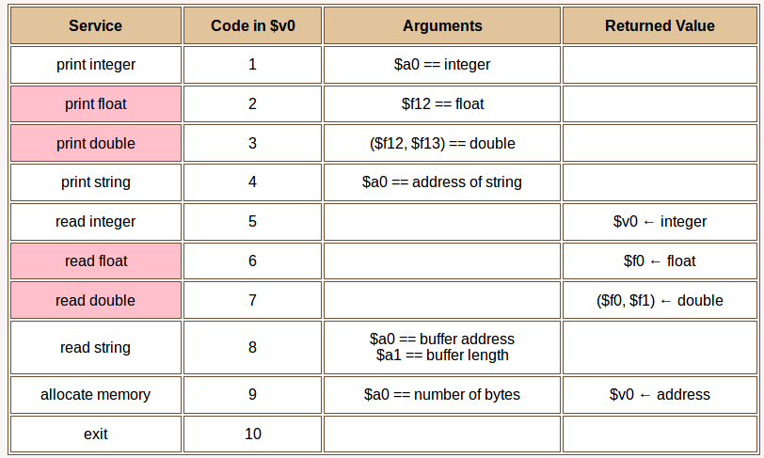
System Calls

